Slide 1
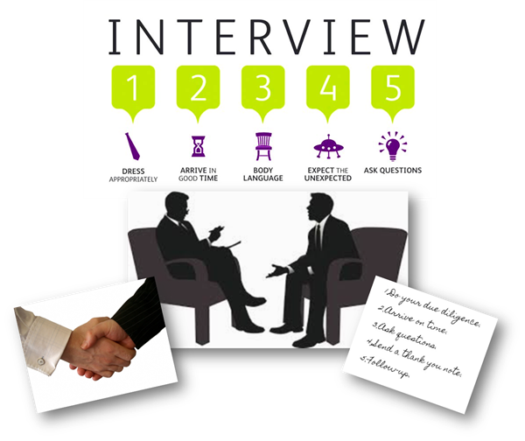
Skills and Techniques
Dr.R.Ganesasubramanian
Assistant Professor

Slide 2
Meaning of an interview
The word interview comes from Latin and middle French words meaning to “see between” or “see each other”. Generally, an interview means a private meeting between people when questions are asked and answered
Interview = A meeting with an objective
Employer’s objective is to find the best person for the job
Employer: reviews candidate’s experience and abilities
Can you do the job? (skills, abilitie, qualifications)
Will you do the job? (interest, attitude & motivation)
How will you fit into the organisation? (personality)

Slide 3
Objectives of Interview
In the selection process, interview serves the following
1. Verifies the information obtained through application form and tests.
2. Helps obtain additional information from the applicant otherwise not available.
3. Gives the candidate necessary facts and information about the job and the organisation.
4. Helps establish mutual understanding between the company and the candidate and build the company’s image.

Slide 4
Facts of Interviewing
Interviews are the most widely used process for screening job applicants.
They provide the most direct information about a candidate’s background, personality, and skills.
The purpose of an interview is to receive the job offer.

Slide 5
Know Yourself
Employment objective and how it relates to the position and the employer
Educational background and how it relates to the position and the employer
Work experience
Abilities and skills
Always be able to give examples!

Slide 6
Know the Employer
Research! Research! Research!
Prepare to demonstrate your knowledge of the profession and the company
Prepare to give reasons for your interest in working in that profession/company
Develop questions in advance to ask about the job/organization

Slide 7
Interview Preparation
Situational Knowledge
Where/when the interview takes place
Arrive 10 minutes early!
Physical Preparation
Get plenty of rest
Dress for success
Mental Preparation
Knowledge of company
Practice a mock interview
Written Preparation
Take extra resumes, references, etc.
Make notes
Ask questions

Slide 8
Preparation is the key to success
Review own skills, experiences and qualities
Check CV
Anticipate questions and identify relevant examples
Prepare key selling points
Research organisation
Websites, reports, articles, company literature, etc
Contacts with knowledge of organisation or sector
Relevant articles in the press
Personal visit or telephone call
Research job and occupational area
Job description – or similar
Current issues
Prepare your questions
Practice

Slide 9
Types of Interviews
Basic/traditional interview
Telephone interview
Group interview
Interview during a meal or social occasion
Serial interview

Slide 10
5 Stages Interview Process
Icebreaker
Greetings
First Impressions
Small talk
Personal Qualifications and Interest in Position
Abilities, Skills, and Work Experience
Accomplishments and Activities
Goals

Slide 11
Interview Process
3. Organization and Position
Employer may test your knowledge of the company.
“Why do you want to work for this company?”
“What do you know about this department?”
Other general questions regarding the company or the job.
“What is your geographic preference?”
“Are you willing to relocate?”

Slide 12
Interview Process
Candidate Questions
Your chance to ask questions about job
“What type of on the job training do you provide?”
“What makes your company different from its competitors?”
Close and Follow-Up
Find out who makes next move
Thank the interview for their time
Evaluate your performance
Send a thank you note within 24 hours

Slide 13

STAR Technique
Situation – describe the situation, problem, or issue that you encountered.
Task – describe the tasks/responsibilities you took on to help solve the problem.
Action – discuss the steps you actually took to effect a solution.
Result – describe the positive results of your actions.

Slide 14
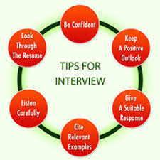

Tips for Successful Interviewing
Interviewing is a two-way process
Never give “yes” or “no” answers
Listen carefully and react
Use specific examples to make your case
The interview begins the minute you step onto the company lot
Be positive!

Slide 15
Tips for Successful Interviewing
Think like an employer
Don’t criticize past employers or co-workers
Be aware of illegal questions
Maintain professionalism, even if the employer does not
Be prepared for the unexpected
Be aware of body language
Be well-groomed

Slide 16
Watch the Body Language
First impressions very powerful
Allow time to relax
Dress appropriately
Entrance, introductions & handshake
Smile and make eye contact
Be aware of own movements
Watch body language of interviewer

Slide 17
Typical Questions
About you
Tell me about yourself - Bring me up to date with your CV?
Why did you choose that particular degree programme?
What experience have you had that is relevant to this post?
What would you consider your major achievements to date?
About the job
What interests you about this job?
What do you know about this organisation?
What other options are you considering?
How do you see your career developing – 5 years?
If you were Head of Department, what would be your priorities?
General knowledge
What do you think of the Government’s policy on college fees?

Slide 18
Competency-based Interviews
Company identifies key skills required for job
Designs questions to elicit evidence of skills
Emphasis on past behaviour as predictor of success
Teamwork: Describe a team project you worked on. What problems arose? How did you deal with them?
Communication Skills: Describe situation when you had to persuade others to support your view. Give an example of any reports you’ve written which illustrate your writing skills
Interpersonal skills: What kinds of people do you find it difficult to work with? How do you handle those situations?
Taking Responsibility: Describe a time when you took responsibility to achieve a challenging goal
Problem-solving:Tell about a time when you had several tasks to manage at one time with conflicting deadlines.

Slide 19
Preparing for Competency Interview
Identify the competencies required for job
Review job description or ask for information
Define each competency in behavioural terms
Identify past experience to illustrate how you demonstrated that behaviour
Prepare examples for each competency
Practice talking about your experience
Try to give a complete answer - STAR

Slide 20
Matching Skills to Requirements
Employer needs
Communication
Team work
Leadership
Initiative
Customer Care
IT
Commercial awareness
Your evidence
Presentation to class
Example from Coop
Class rep, Committee
Fundraising for charity
Working in Supergun
Designed website
Business pages

Slide 21
Your Answers
Listen carefully, seek clarification
Illustrate answers with real examples and evidence
Be positive – constructive criticism
Keep answers specific and brief
Take time to respond
Be alert to interviewer’s body language
Speak clearly, smile and show enthusiasm
Know what you want to say, and find the opportunity

Slide 22
Qualities Employers Seek
Good all-round intelligence
Enthusiasm, commitment and motivation
Good communication skills
Team work ability
Ability to solve problems
Capacity to work hard
Initiative and self-reliance
Balanced personality

Slide 23
Competencies required by Company
Adaptability
Integrity
Innovation
Teamwork
Initiative
Drive for Results
Know the Business
Open Exchange of Information
Makes Difficult Decisions

Slide 24
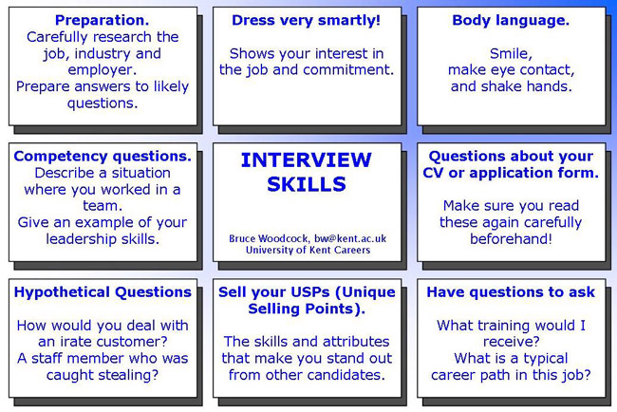

Slide 25
Your Questions
Training programmes
Career development opportunities
Types of projects & responsibilities
Reporting structure
Performance appraisal
Profile of staff
Questions about topics raised in interview
What happens next?

Slide 26
Interview Marking Sheet
Name | Mark-max 100
Communication Skills | Max 30
Problem Solving | Max 20
Team Fit | Max 20
Relevant Experience | Max 20
Project Management | Max 10
Total Marks

Slide 27
Interview Rating Scale
Rating: 0-5; 0=no response; 5=excellent
Selection Criteria
Intelligence – Academic performance, Questions
Responsibility – Work roles, external activities
Appearance & poise – First impressions
Interpersonal relations – Interests, team-roles
Integrity – no inconsistencies
Self-confidence – Relaxed manner, responsible
Communication skills – Articulate, coherent, grammar, responsive
Interests – External interests, involvement
Leadership potential – Elective offices, initiative
Interviewing skills – Logical thinking, knows priorities

Slide 28
What creates a bad impression
Poor personal appearance
Negative attitude – evasive, using excuses
Lack of interest and enthusiasm
Lack of preparation
Poor knowledge of role
Failure to give concrete examples of skills
Over emphasis on money/rewards
Lack of career plan

Slide 29
After the Interview
Review own performance
what went well
what went badly
what you wished you had said
prepare for next stage
Invitation to second / final round interviews
assessment centre
psychometric testing
panel interview
Rejection letter / email
if you can request feedback - use it

Slide 30
Telephone Interviews
Prepare as thoroughly as for ‘real’ interview
Select comfortable, private, quiet place
Have copy of CV and company information
Have pen and paper at hand
Prepare for usual interview questions
Practice on phone
Record answers
Try standing
Smile and use gestures
Avoid monotones
Be yourself

Slide 31
Other Types Of Interviews
Rotating
Like one-to-one with different interviewers
Group
6-8 candidates
Group observed while discussing topic
Be aware of group interaction
Panel
2-5 interviewers, or as many as 13!!
Try to identify different roles
Respond to interviewer, include others through eye contact
May involve presentation

Slide 32
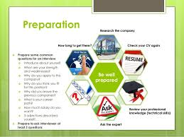

Interview preparation

Slide 33
Before The Interview
Research the potential employer
Review the job description and be able to match your experience and education with the duties of the position
Prepare a 1 to 2 minute script about yourself
Make sure you have the appropriate interview attire

Slide 34

Tips Regarding Attire (Men)
If possible, wear a suit to the interview
Belt and shoes should be same color
Avoid ties with elaborate patterns or too many colors
A wedding ring and/or watch is generally the only jewelry that should be worn
Head to Toe: Hair should be well groomed and shoes should be polished

Slide 35
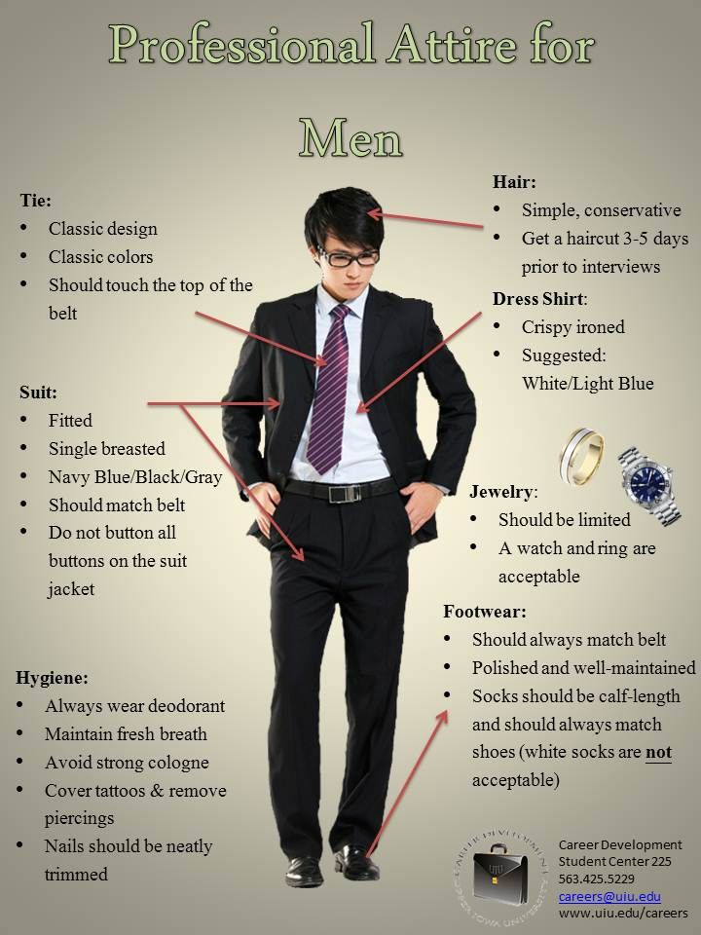

Slide 36
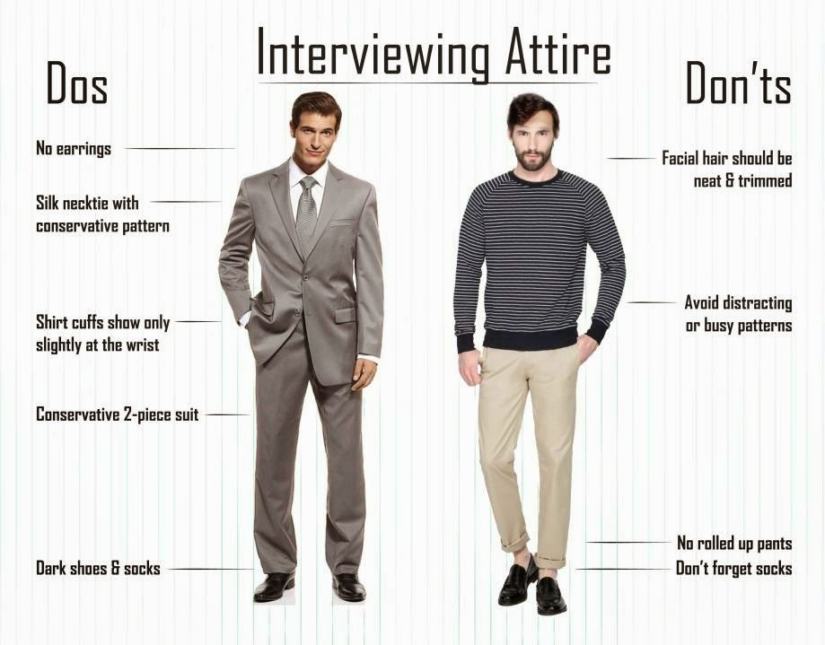

Slide 37
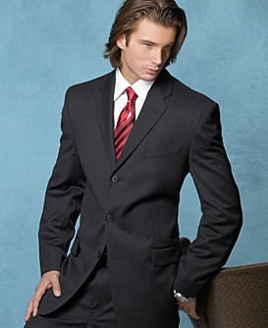
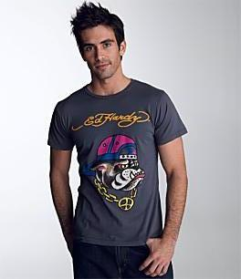
Who Would You Hire?

Slide 38
Tips Regarding Attire (Women)
A suit or dress is preferable
Skirts should meet at the top of the knee or longer
The amount of jewelry should be minimized
Make-up should be light
Avoid perfumes and scented powders

Slide 39
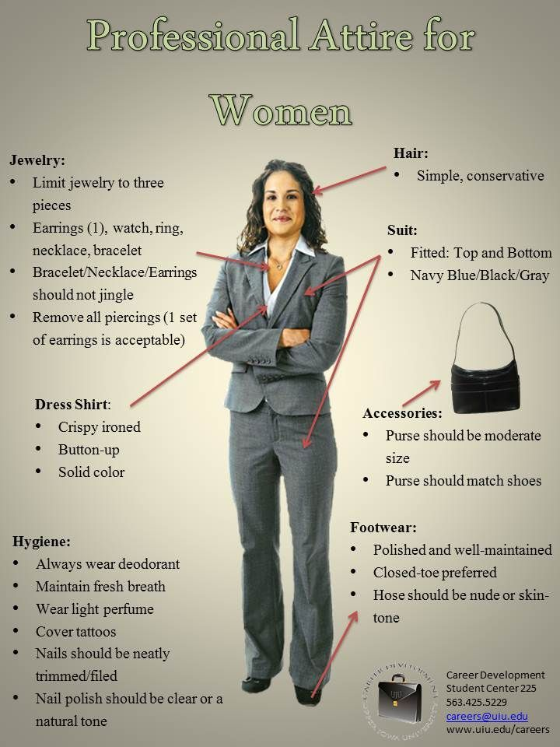

Slide 40
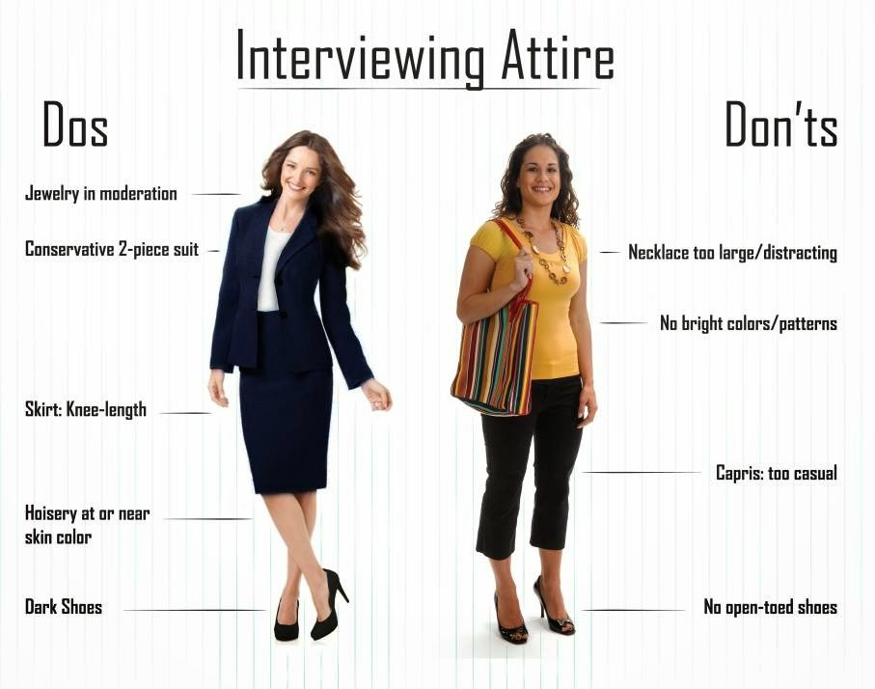

Slide 41
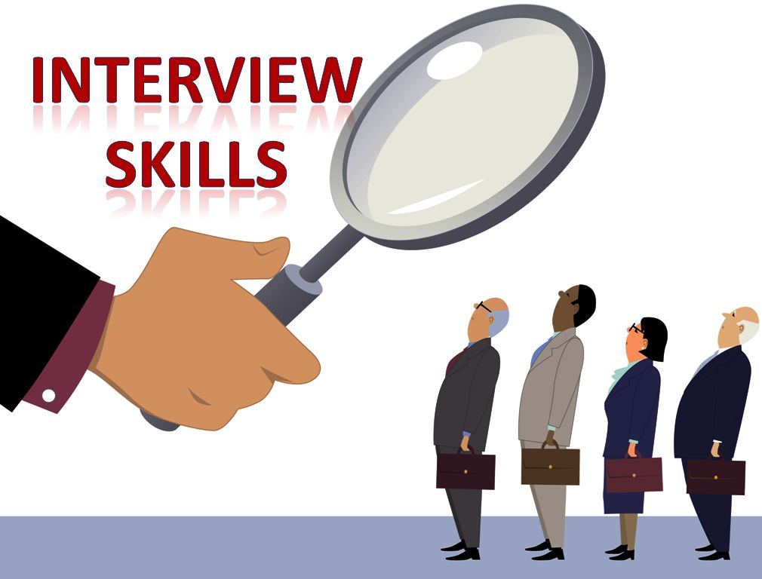

Starting The Interview
Be sure to arrive 10 to 15 minutes prior to the start of the interview
Greet the interviewer with a firm handshake
Maintain good eye contact and posture
Make sure you are energetic and enthusiastic
Speak clearly and articulate

Slide 42
Standard Interview Questions
Would you tell me about yourself?
What is your greatest strength?
What is your greatest weakness?
Where do you see yourself in 5 years?
What about this position do you find most appealing?
Why do you want to work for our company?
Why should we hire you?

Slide 43
The five most important factors interviewers considered when hiring
Work experience (36%)
First impressions of the candidate (24%)
Education (12%)
Professional qualifications (10%)
References (9%)

Slide 44

Ask Questions
What are your expectations of the employees in your company?
What are the strengths and weaknesses of your organization?
Describe a typical day on the job in this position.
Avoid asking questions about salary and benefits.

Slide 45
Graceful Exits
Thank you for your time
I appreciate it
I will be looking forward to hearing from you

Slide 46

After the Interview
Evaluate your performance
Send a thank-you note within 24 hours
Keep records of important dates and details for the follow-up

Slide 47


